Slide 1
Diwali Sales analysis eda
Syed Ali Hussain
nawazhussainali46@gmail.com

Slide 2
Problem STATEMENT
To perform an exploratory data analysis of Diwali sales data to understand sales patterns, customer behavior, product performance, and other relevant insights. This will help in identifying trends, anomalies, and opportunities for improving sales strategies and business decisions for the Diwali season.

Slide 3
DATA OVERVIEW
Overview of the Analysis
Breif introduction to the dataset
Description of the dataset
Key features/columns
Source of the data

Slide 4
Technologies used:
Programming language:
Python: primary language used for data analysis and visualizations
Libraries:
Pandas: For Data manipulation,cleaning,and preprocessing
Seaborn: For creating statistics visualizations such as bar charts,
line charts ,scatter plots.
Matplotlib: For creating statistics visualizations such as bar charts,
line charts and scatter plots
Numpy: For numerical computations and handling large arrays of data
Data Visualizatiion tools:
Matplotlib and seaborn: Used within python to Generate a variety of visualizations

Slide 5
Steps taken for data cleaning and preprocessing:
Data Loading: Load the dataset into a pandas data frame
Handling Misiing Values: Idendified and filled or removed missing values to ensure data integrity
Data type conversion: Conversion of columns like related to dates or categorical data
Handling duplicates: checking and removing the duplicate rows and columns

Slide 6
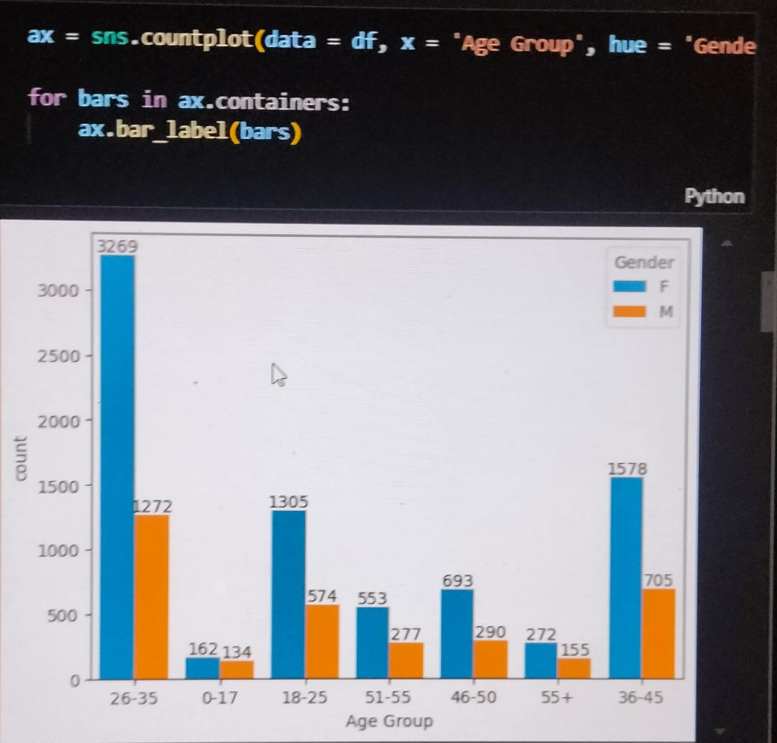
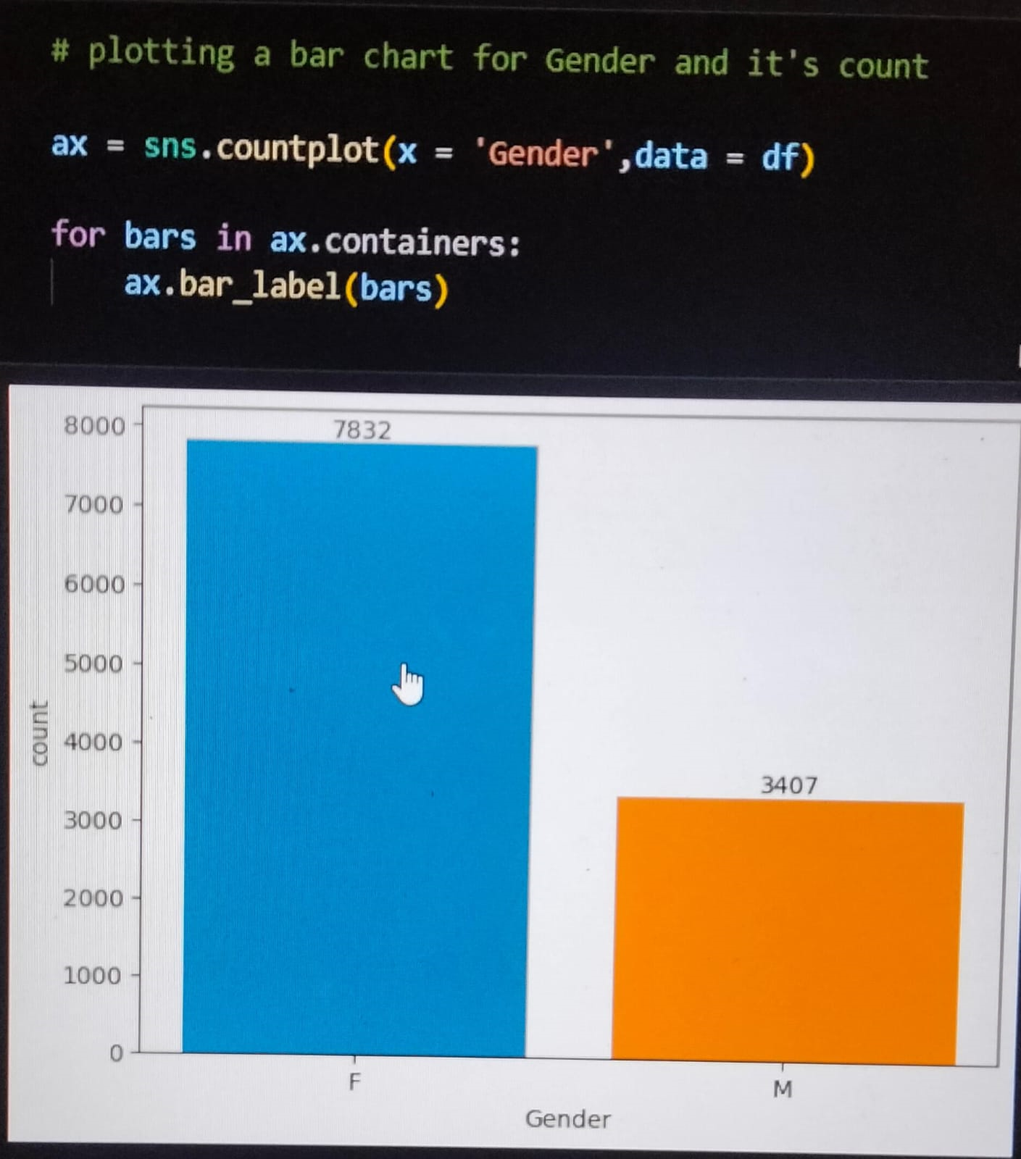
Gender Analysis AND AGE ANALYSIS

Slide 7
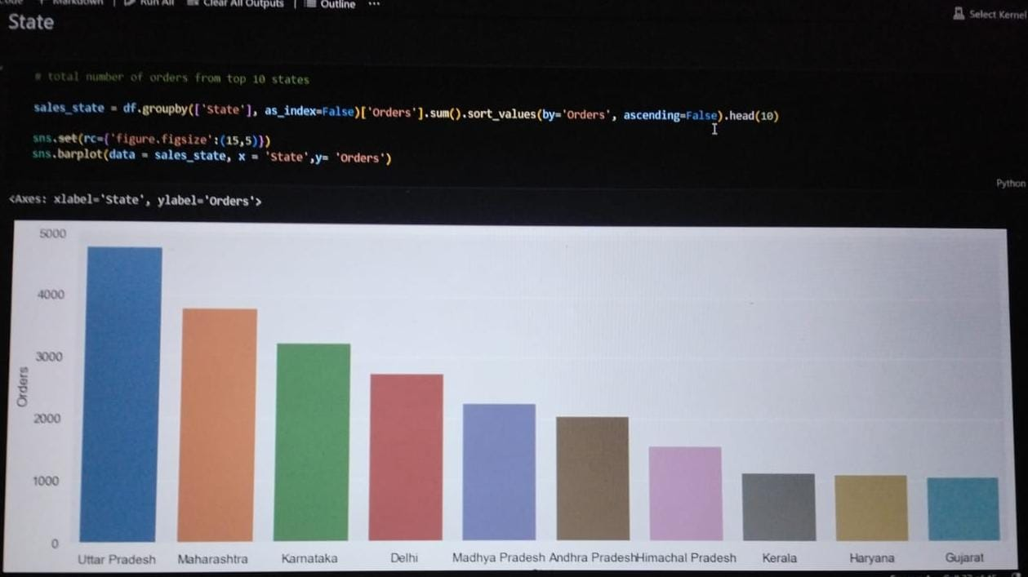
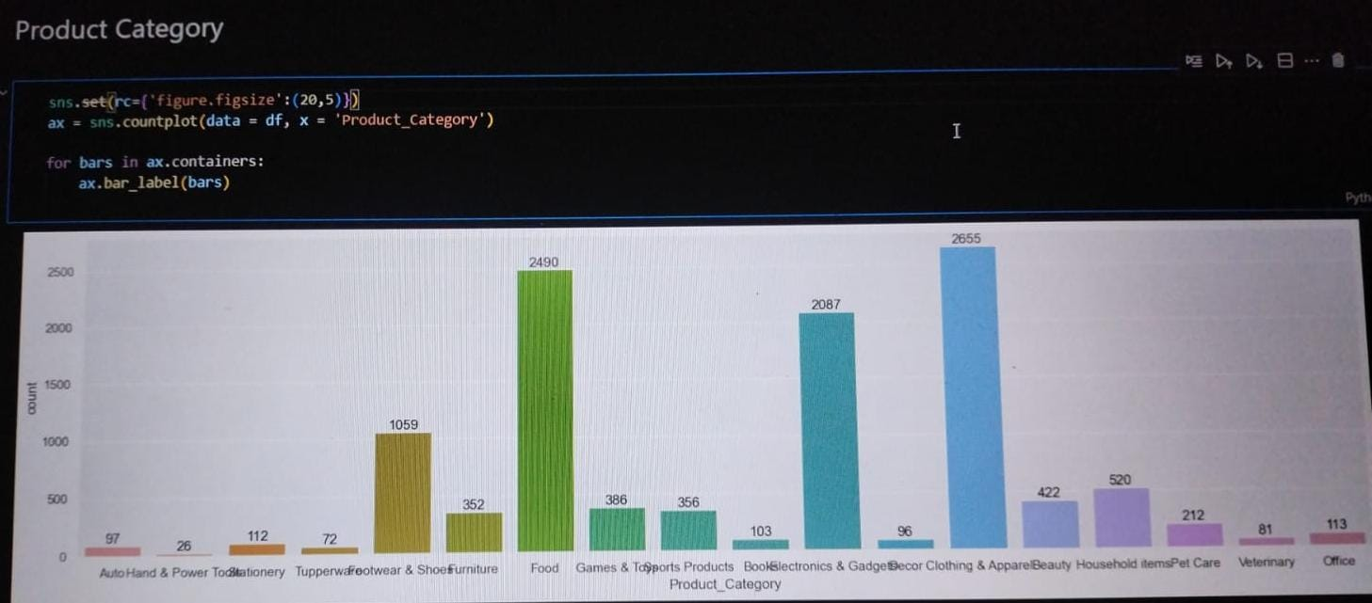
STATE WISE-DISTRIBUTION AND PRODUCT CATEGORY ANALYSIS

Slide 8
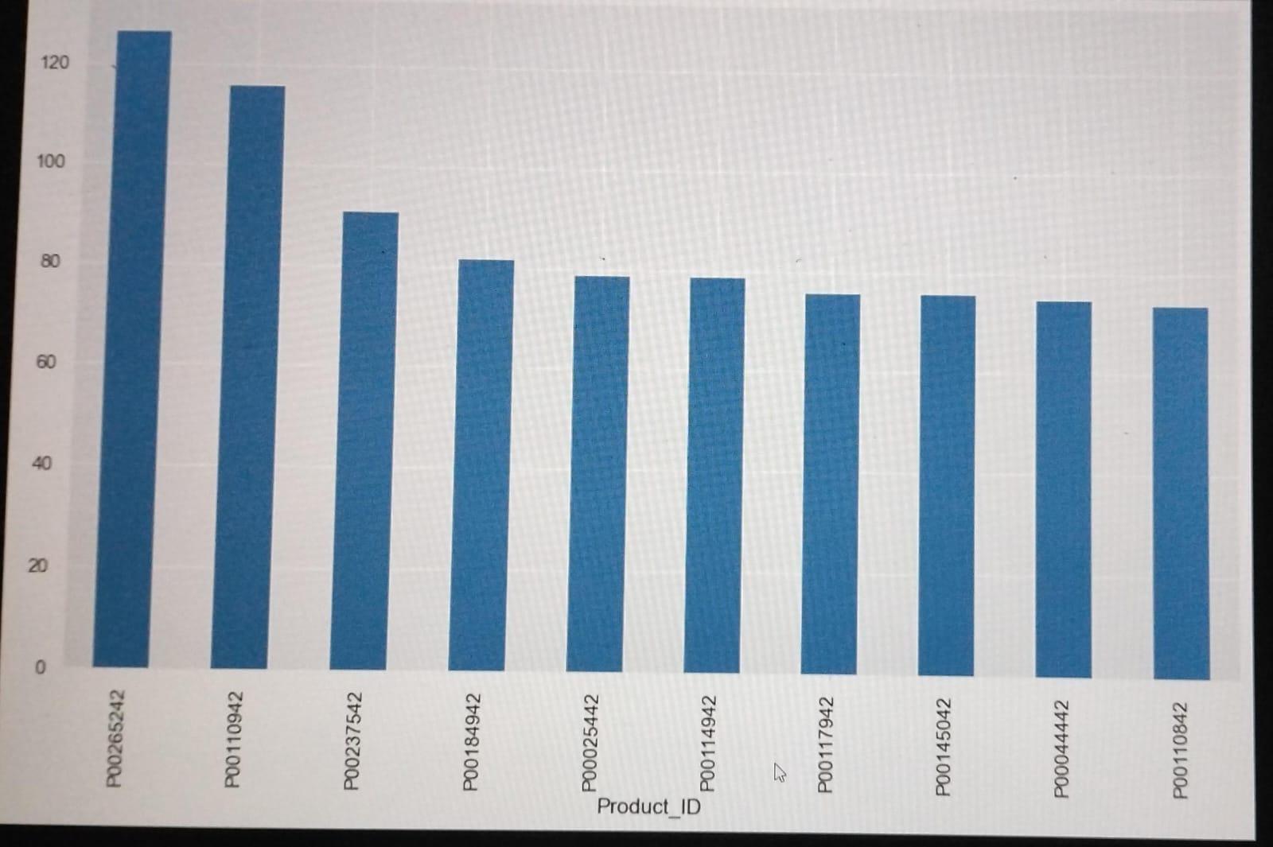
SALES TREND ANALYSIS

Slide 9
CONCLUSION:
Geographic Insights:
State-wise Distribution: States like Uttar Pradesh, Maharashtra, and Karnataka probably had the highest sales, indicating these regions as key markets. Expanding marketing efforts in these states could further boost sales.
Sales Trends:
Peak Sales Period: Sales likely peaked in the days leading up to Diwali, indicating that promotions and discounts should be intensified during this period to capitalize on the buying frenzy.
Timing: Early promotions might have had less impact, while those closer to the festival likely drove the most sales.
OVERALL ANALYSIS:
The Diwali Sales Analysis provides valuable insights into consumer behavior, demographic preferences, and regional sales patterns. By aligning future marketing and inventory strategies with these findings, businesses can optimize their sales and customer engagement during the festive season.

Slide 10
THANK YOU

